Slide 1


PARTNERSHIP LED ● CLIENT CENTRED ● RESULTS FOCUSED

Slide 2
Background
Like many busineses intelliHub was founded out of a belief that something could be done better; in this case it was Management Consulting which, from a client-side perspective, frustrated on a number of levels.
​
Similar businesses may be described as disruptors, at intelliHub this isn't a label that we would pick, instead we believe we are simply doing things the best we can, while standing by the principles that the business was founded on:
​
Transparency - from our fixed pricing to the projects we deliver, we seek to ensure total clarity for our clients, it is the only way we know.
Partnership - we don't believe in simply doing a project then move on; every project we deliver is supported with a program of follow-up 'health checks' in order to ensure desired results are achieved.
Expertise - at intelliHub we ensure that our clients benefit from the input of subject-specialists; we have cultivated a wide network in order to ensure the right delivery, first time.
Independence - we don't tie ourselves to any one solution, this means that not only will we bring the right blend to the table, but if desired, projects be delivered in conjunction with a client's preferred partners/suppliers.
Bespoke - every business is unique, even the closest competitors; for this reason, every project we undertake is done from scratch as we build a bespoke solution that strengthens what makes our clients unique.

Slide 3
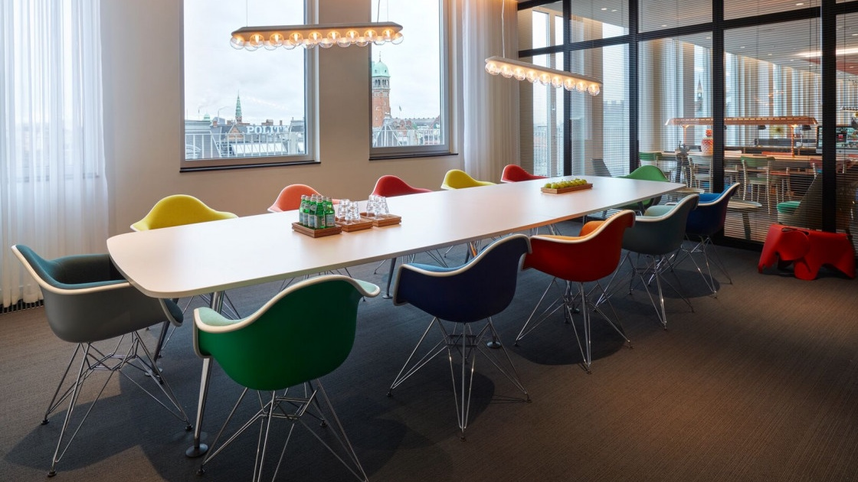
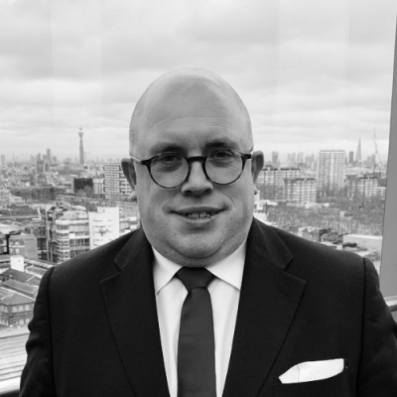
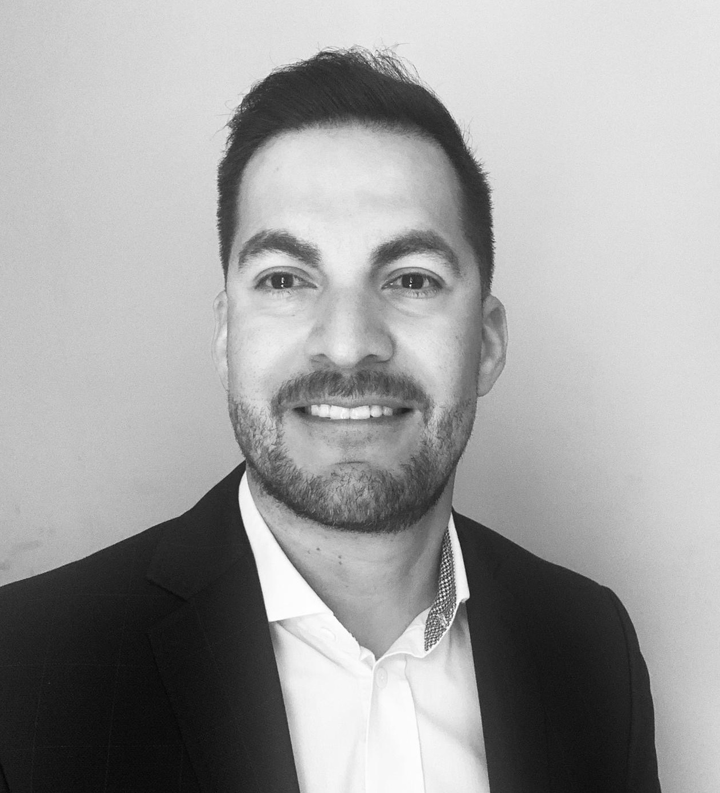
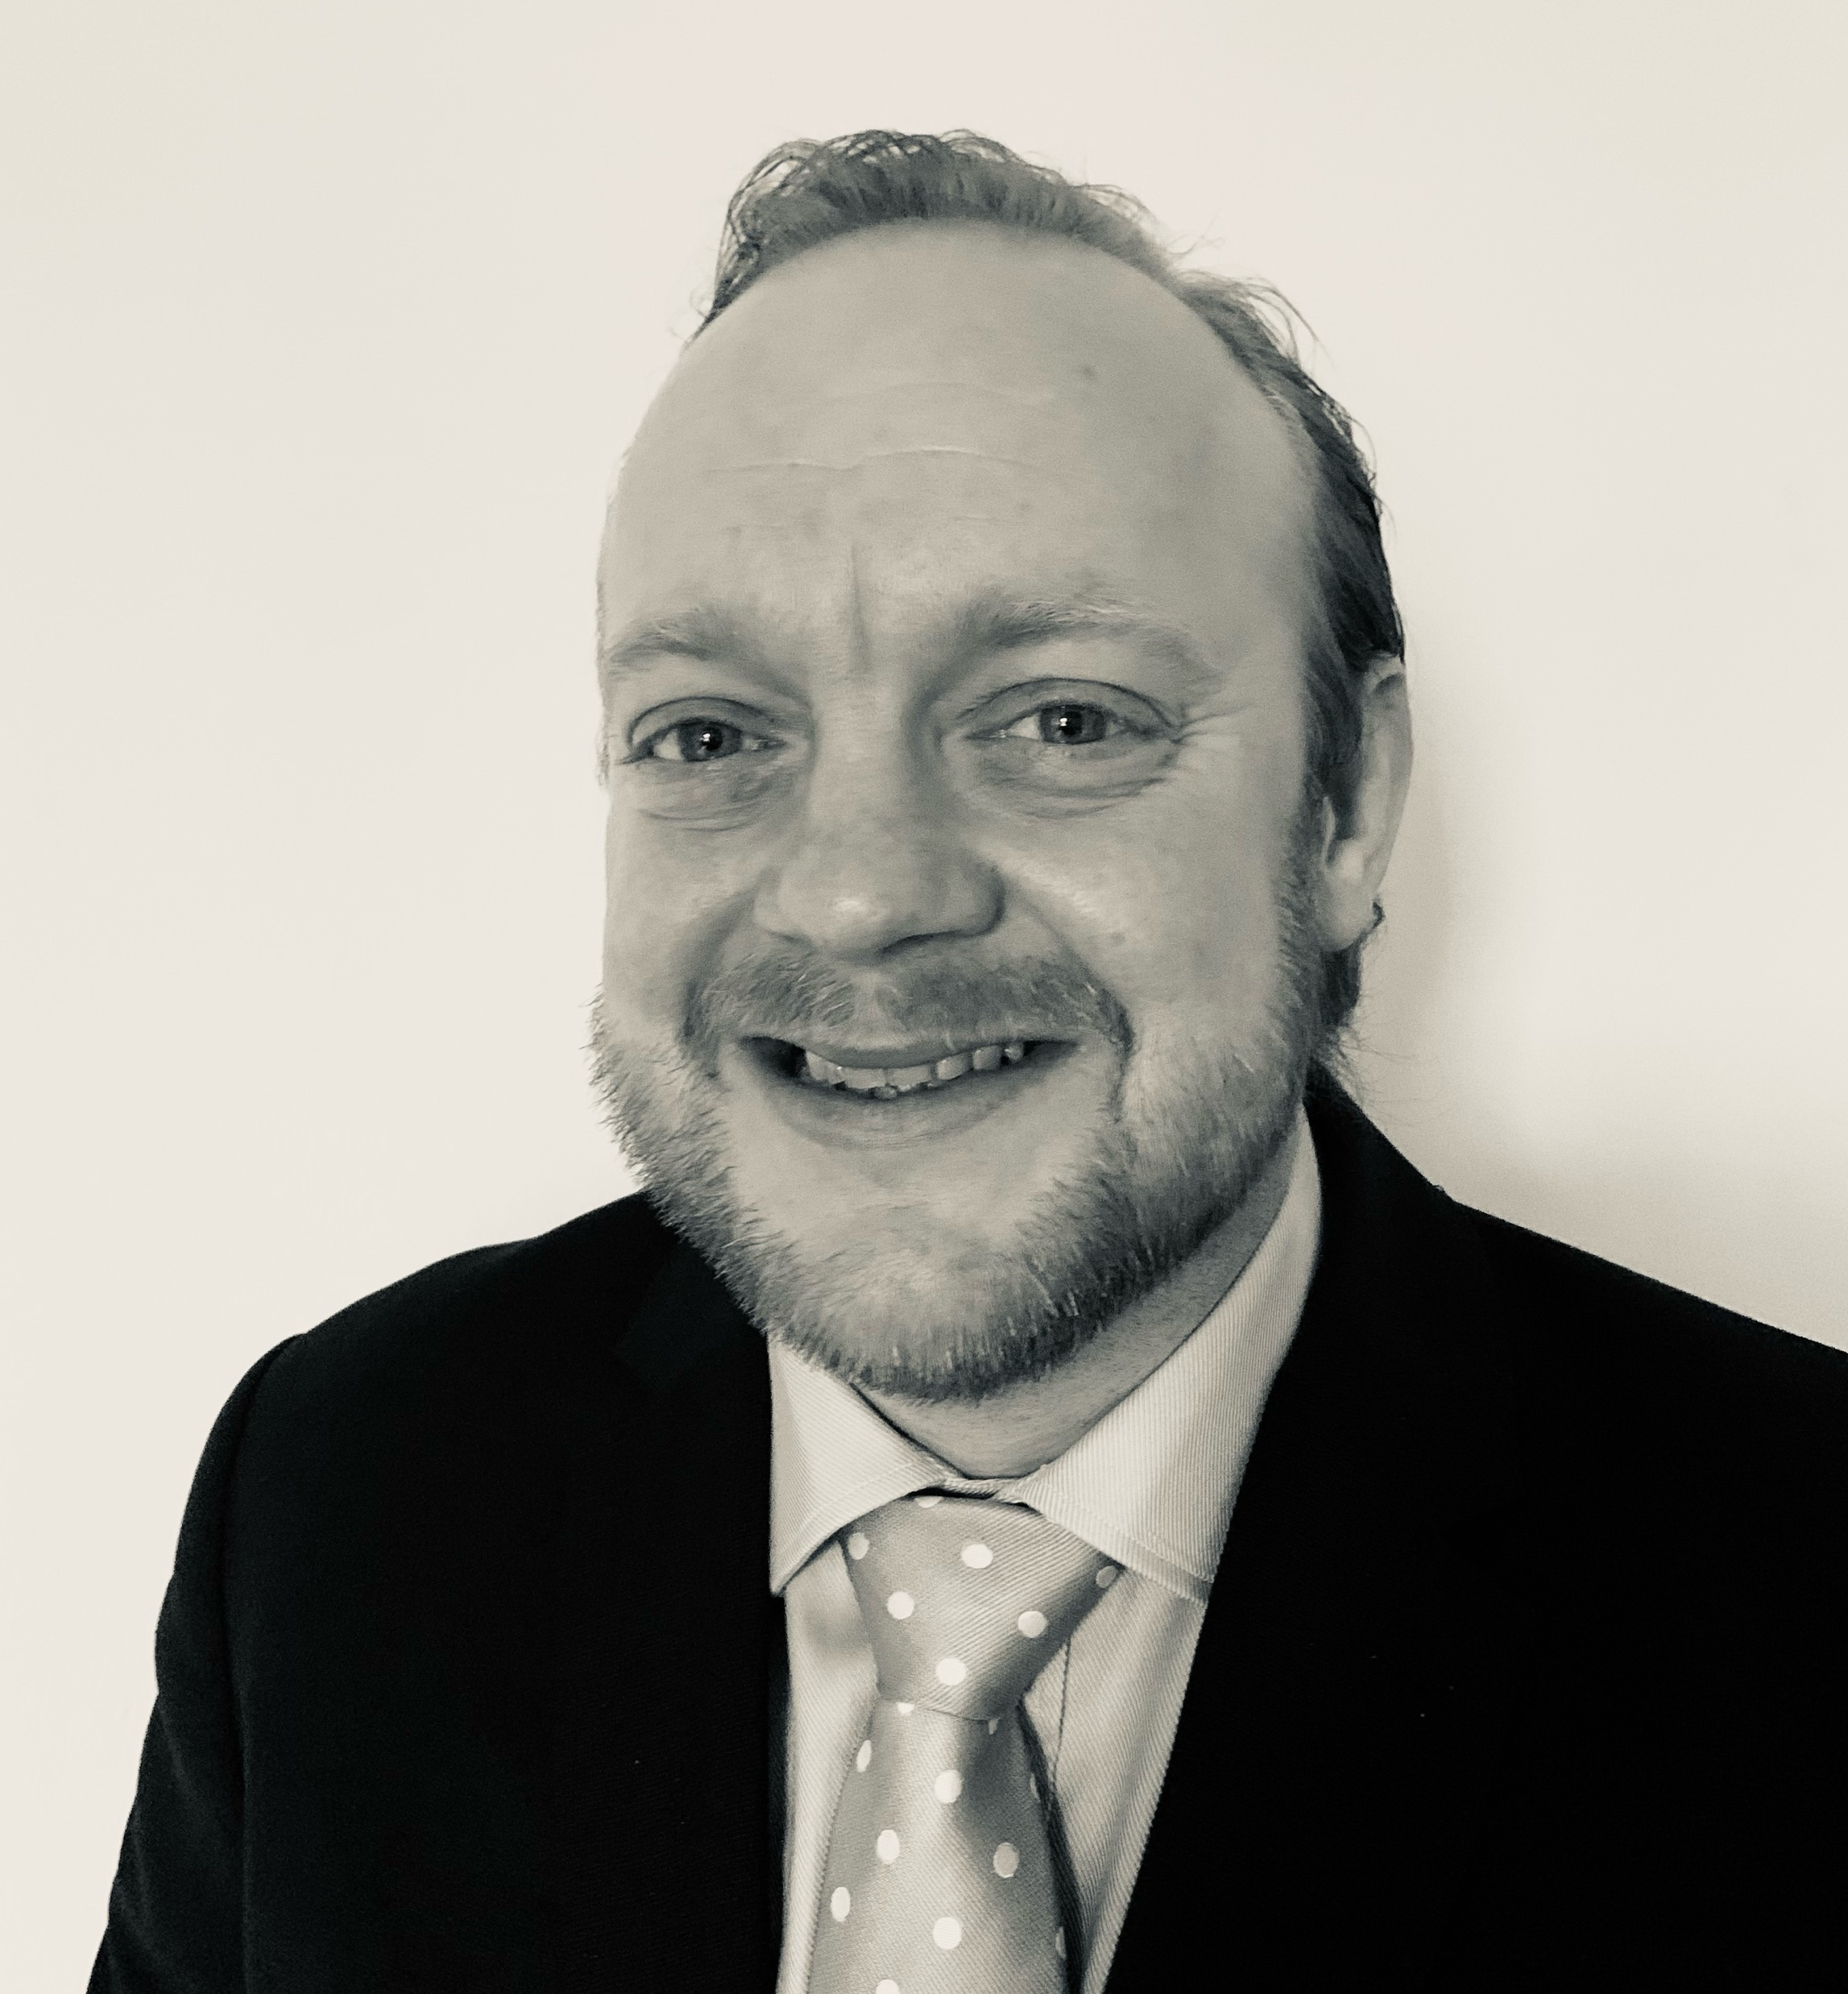
Our Leadership
The team at intelliHub brings together a broad spectrum of experience built delivering a diverse array of projects; some of these include:
Ben McBrown –
Marketing Director
Noel Castillo –
Managing Director
Matthew Benwell –
Customer Engagement Director
With a background in Talent Consulting, Ben has worked with clients and has led projects to build teams across all commercial departments. Recently, Ben has successfully completed a Mini-MBA in Marketing and certifications in subjects including Diversity and Inclusion.
Lean Six Sigma Black Belt certified specialist with 20 years experience in change management and cost reduction, Noel has led hundreds of projects delivering more than $300million in tangible savings while finding significant revenue generation opportunities.
Matt is passionate about new ideas, networking and business development. If there is a game-changing idea – he likes to be a part of it. He has a background in telecoms, where he was part of the setup of a dynamic trading solution, and was also a Sales and Partnership Director in Hong Kong.

Slide 4

Expertise
The team at intelliHub brings together a broad spectrum of experience built delivering a diverse array of projects; some of these include:
Operating
Cost
Reduction
Workplace Hybridisation
Organisational Restructuring
Talent Acquisition & Retention
Supply Chain Optimisation
Insurance & Collections
HR Policy Development
Revenue Optimisation

Slide 5

Our Solutions
Not only does intelliHub offer a wide spectrum of expertise, but we are also able to enter into engagements at a range of project stages; for example:
Operating Strategy Definition
Readiness Assessment
Requirement
Analysis
Solution
Design
Transformation Implementation
Snagging & Optimisation
While our greatest successes come from engaging at the earliest possible stages, intelliHub is proven to be able to steer projects back on-course and to a successful outcome.

Slide 6
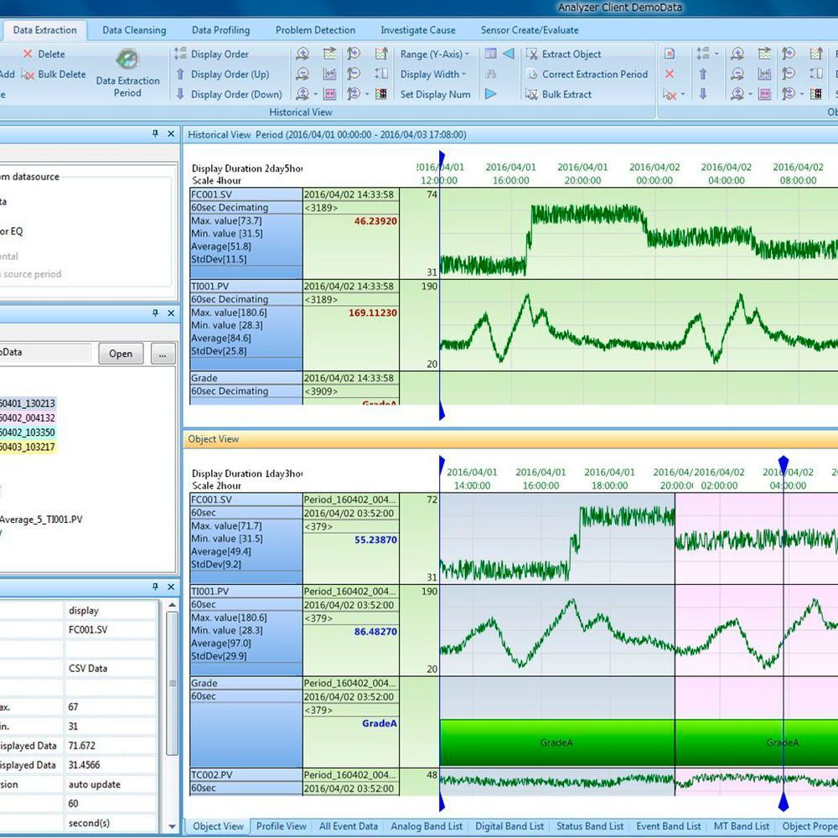

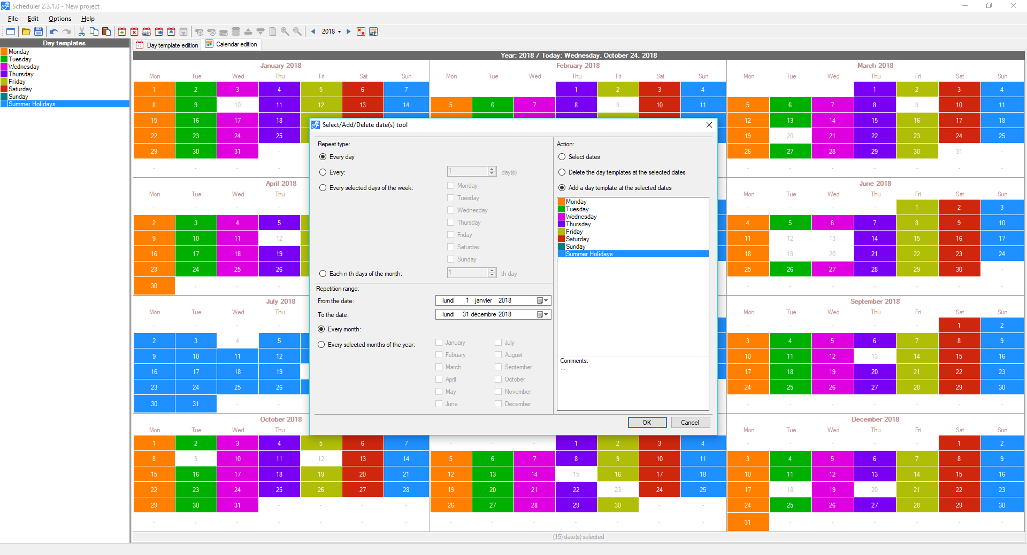
intelliHub Hybrid Workplace Suite
Key to any workplace hybridisation project we undertake, the intelliHub Hybrid Workplace Suite is a bespoke toolbox built for every client to support their transformation to hybrid and further decision making. Each HWS combines:
Insight
Strategy
Tools
Examples:
・Recommendations for
change
・Space re-design
・Transformation Roadmap
・Further Findings
Examples:
・Organisational Operating
Rhythm
・Individual Operating
Rhythm
・Space Requirement
Calculator
Examples:
・Financial Business Case
・360º Reporting
・Property Portfolio Analysis
・Employee Preferences
Clients find value from the HWS when making decision ranging from recruitment to FM issues.

Slide 7

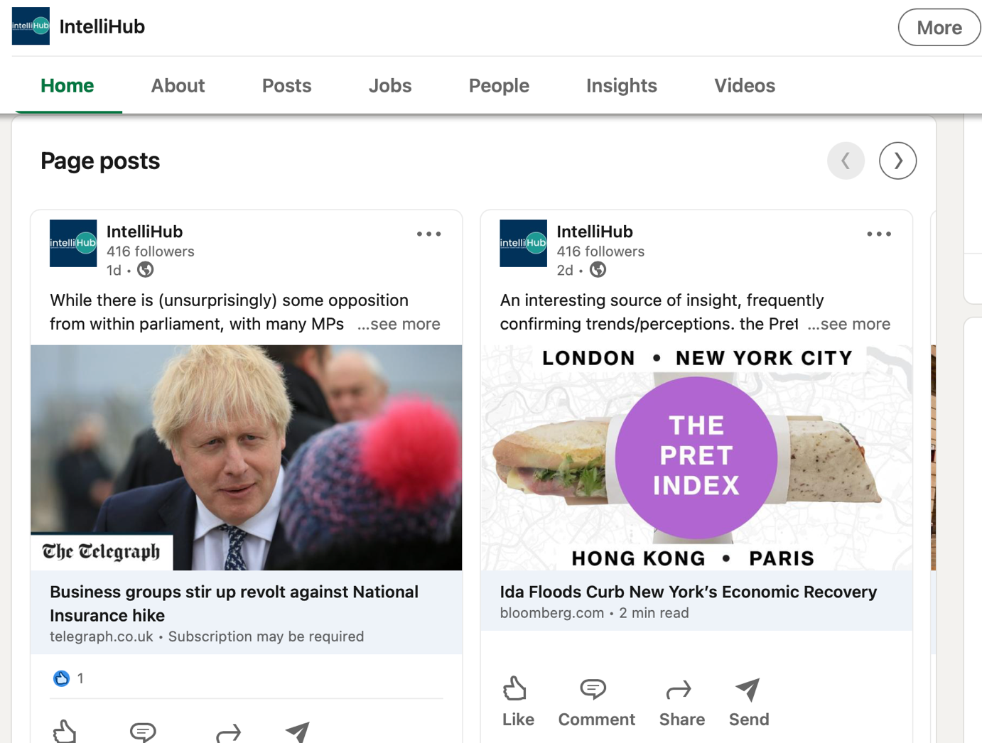
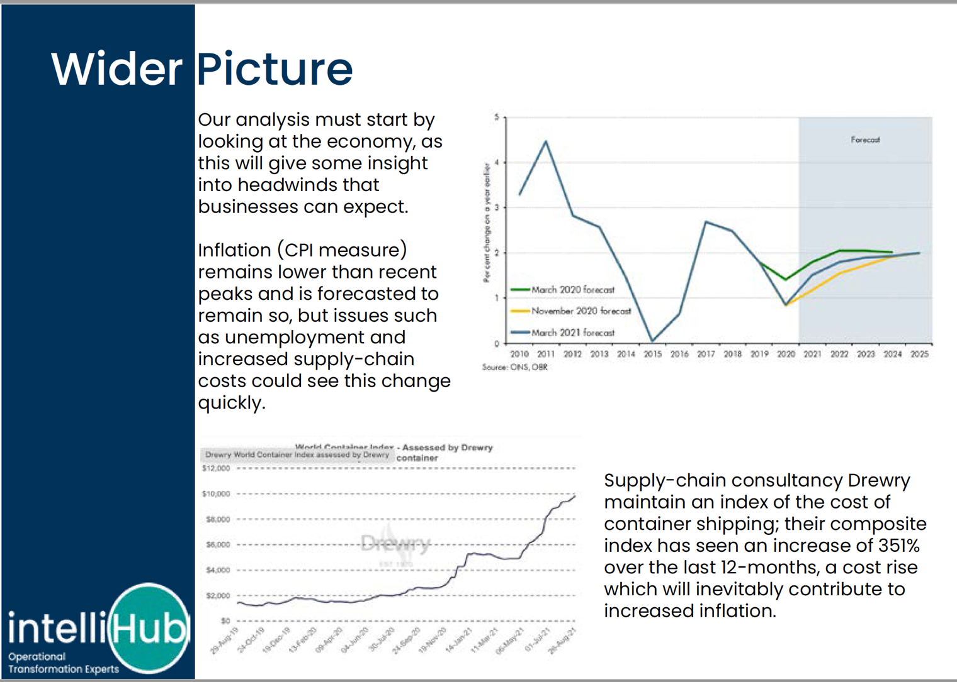
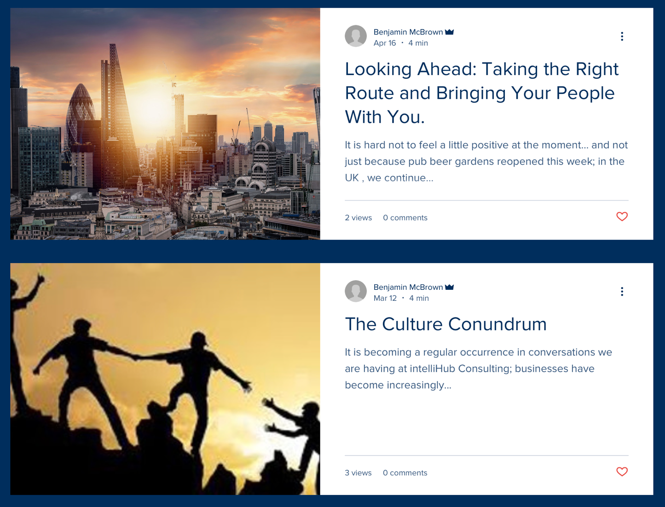
Value Added
We continuously aim to add value for our clients and partners; utilising our ongoing research we produce the following on a daily, weekly and monthly basis:
Articles
News Updates
Reports

Slide 8


Case Study: RLS Law
Our Task
The firm’s partners have come to realise that a hybrid working strategy
could be of significant benefit to their business and its people alike,
but needed support with a guided implementation, to realise benefits
and achieve long term sustainability.
​
Pre-pandemic the business operated with a structure which allowed a level of flexible working for certain staff, but their office space continued to accommodate everyone in the business together.
​
Technology become an issue as the needs from working remotely are different, RLS had secured a proposal from an IT Contractor but were keen to understand how intelliHub would recommend proceeding.
Tangible Benefits
Partners at RLS Law are to action intelliHub's recommendations with a view to implementing changes in line with an upcoming lease break. If intelliHub’s recommendations are implemented RLS will deliver:
​
Up to 43% savings per annum or rent, this would far exceed the costs of…
​
IT transformation which could save RLS 75% of the costs, compared to the original proposal.

Slide 9
RLS said:
The IntelliHub team did a fantastic job for us. They spoke to our whole team to really understand the needs and wants of both the business and the staff, and in doing so put together a flexible work strategy that works for both the employers and the employees, to drive productivity and at the same time keep employees happy.
The fact that external consultants were appointed to consider the wellbeing of the staff and their desired future working arrangements was well received by our team and reflected well on our company.
The report prepared by IntelliHub gives us a clear strategy that equips us well for a future of a office / home hybrid working in this fast changing world.”
Julien Rutler, Managing Partner; RLS Law.

Slide 10



www.intellihub.co.uk
+44 (0)203 488 5178
Find Us On Linkedin
PARTNERSHIP LED ● CLIENT CENTRED ● RESULTS FOCUSED

